Slide 1




What is a Cover Letter ?
A Cover Letter is a one-page document submitted with a job application, introducing yourself and explaining why you're a strong candidate for the position. It highlights your relevant skills, experiences, and enthusiasm for the role, complementing your resume.
Presentation On:
Purpose?
Cover Letter
Introduces You – It provides a personalized introduction to your application.
Highlights Key Skills – Emphasizes your most relevant qualifications and experiences.
Shows Enthusiasm – Demonstrates your interest in the role and company.
Group Members: Mohsin Sajjad, Muhamad Musab, Haris Khan

Slide 2
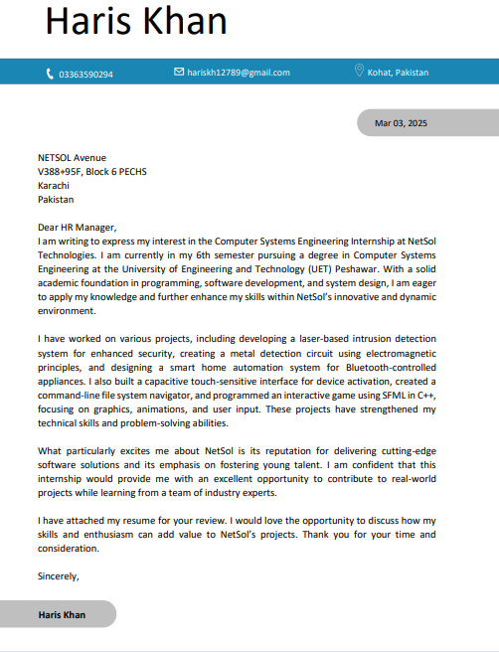
Guidelines
What is a Cover Letter ?
A Cover Letter is a one-page document submitted with a job application, introducing yourself and explaining why you're a strong candidate for the position. It highlights your relevant skills, experiences, and enthusiasm for the role, complementing your resume.
Purpose?
Introduces You – It provides a personalized introduction to your application.
Highlights Key Skills – Emphasizes your most relevant qualifications and experiences.
Shows Enthusiasm – Demonstrates your interest in the role and company.

Slide 3


Guidelines
}
Sender’s Details
}
Receiver Details
}
Salutation
}
Paragraph

Slide 4
Guidelines
}
}
Paragraph 2
Sender’s Details
}
Paragraph 3
}
}
Receiver Details
Paragraph 4
}
Salutation
}
Paragraph

Slide 5
Difference
Guidelines
}
Paragraph 2
}
Paragraph 3
}
Paragraph 4
Feature | Cover Letter | Motivation Letter
Purpose | Supports a job application by highlighting skills and experience. | Explains motivation for applying to an academic or volunteer opportunity.
Focus | Work experience and job-related skills. | Passion, goals, and reasons for applying.
Usage | Job applications. | University admissions, scholarships, research programs.
Tone | Professional and concise. | Personal and persuasive.
Length | Typically, 1 page (250-400 words). | Can be 1-2 pages depending on requirements.

Slide 6





Difference
04
Feature | Cover Letter | Motivation Letter
Purpose | Supports a job application by highlighting skills and experience. | Explains motivation for applying to an academic or volunteer opportunity.
Focus | Work experience and job-related skills. | Passion, goals, and reasons for applying.
Usage | Job applications. | University admissions, scholarships, research programs.
Tone | Professional and concise. | Personal and persuasive.
Length | Typically, 1 page (250-400 words). | Can be 1-2 pages depending on requirements.

